Slide 1
Project Nitin
1) Move Rover in straight line 2) look for yellow marker line to identify ramp using color sensor 2) climb rover up a ramp by adding bit more power to motor 3) stop rover if it hit obsticle using pressure sensor turn rover left and keep turining unti find a clear path 4) Health check , check all sensors and display OK

Slide 2
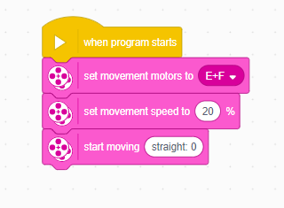
Task 1) Start moving in straight line, with motors connected to E and F

Slide 3
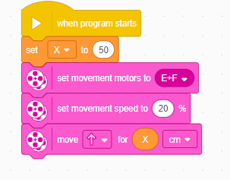
Task 1) Alternative
Start moving in straight line, for a specific time or CM. Variable is also used for your convenience, if needed

Slide 4
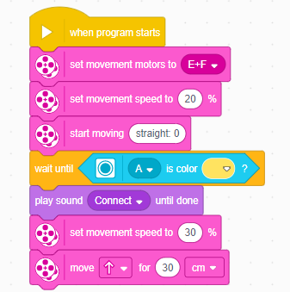
Task 2) Yellow marker
Start moving and when you identify yellow marker, you make a beep sound and increase speed. When it identifies the yellow line, it makes a small sound (you can remove it if you do not need it, it's for testing purposes too), and then increases speed. Please keep in mind that I cannot see the robot so you can adjust the movement speeds to your convenience.
After it detects the ramp, you can make it move for as long as needed. if you want it to move forever, use the "Start moving Straight 0" command like above.

Slide 5
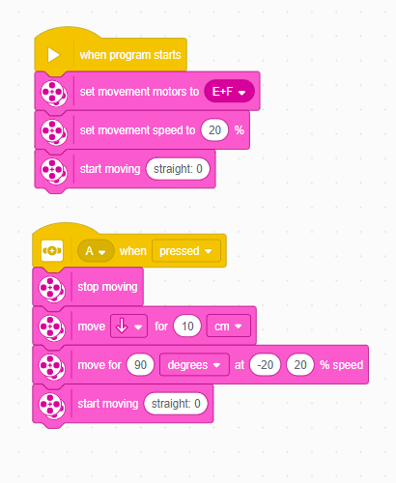
Task 3)
Task 3) Start moving straight. If it hits an obstacle, it will stop moving, go back a bit, turn 90 degrees left, then will start moving again.

Slide 6
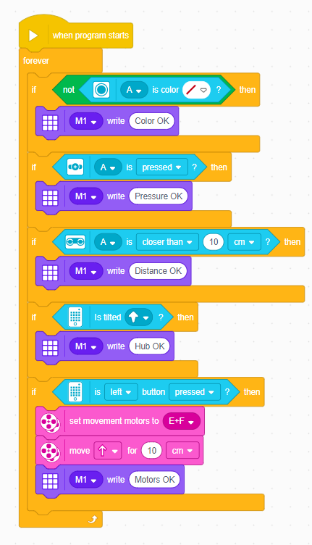
Task 4) Health check
To check and trigger the motors, you will have to press the Left button on the Hub. This will trigger the motors.

Slide 7
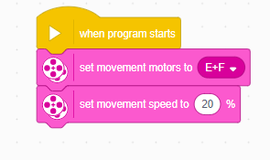
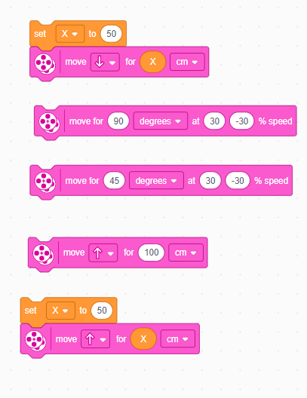
Task 4) for following maneuvers
Basic code blocks. This is the root code, and when you want to test one of the below, just attach it to this code, and it will work.
Specified distance backwards
90 and 45 degrees right. To make it go left instead, use -30 and 30% instead
Move forward for 1 meter
Specified distance forward

Slide 8
Thank you for your time Mr Nitin

